Slide 1
Introduction to Machine Learning

Slide 2
Introduction
To solve a problem on a computer, we need an algorithm.
An algorithm is a sequence of instructions that should be carried out to transform the input to output.
For example, one can devise an algorithm for sorting.
For some tasks, however, we do not have an algorithm—for example, to tell spam emails from legitimate emails.
What we lack in knowledge, we make up for in data.
We can easily compile thousands of example messages some of which we know to be spam and what we want is to “learn” what constitutes spam from them.

Slide 3
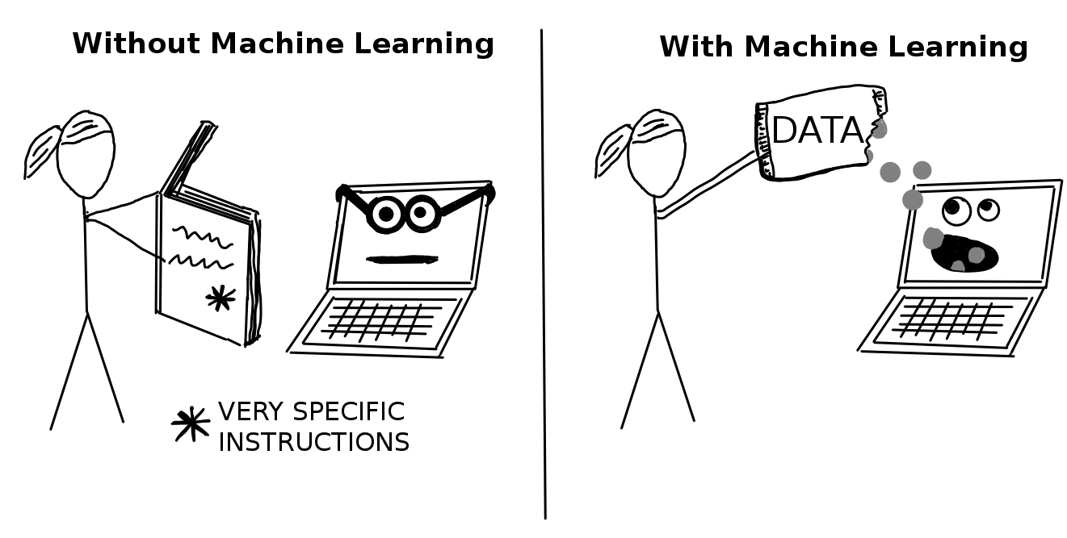
Machine Learning

Slide 4
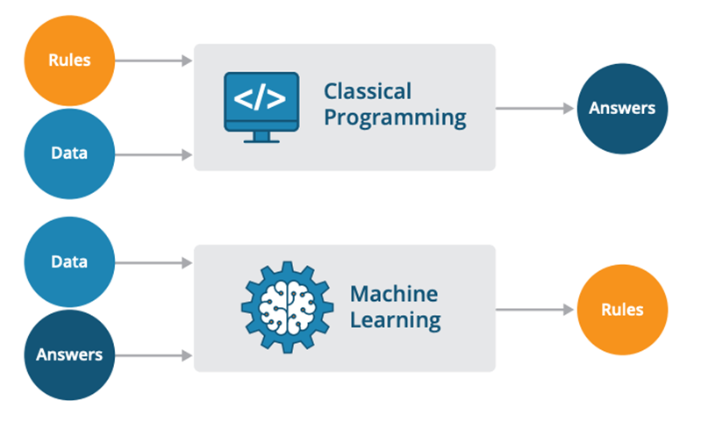
Classical Approach Vs Machine Learning

Slide 5
Definition
Machine learning is programming computers to optimize a performance criterion using example data or past experience.
We have a model defined up to some parameters, and learning is the execution of a computer program to optimize the parameters of the model using the training data or past experience.
Machine learning is turning data into information.

Slide 6
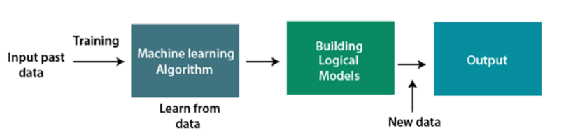
How does Machine Learning work ????
A Machine Learning system learns from historical data, builds the prediction models, and whenever it receives new data, predicts the output for it.
The accuracy of predicted output depends upon the amount of data, as the huge amount of data helps to build a better model which predicts the output more accurately.

Slide 7
Why is ML required?
Rapid increment in the production of data
Solving complex problems, which are difficult for a human
Decision making in various sector including finance
Finding hidden patterns and extracting useful information from data

Slide 8
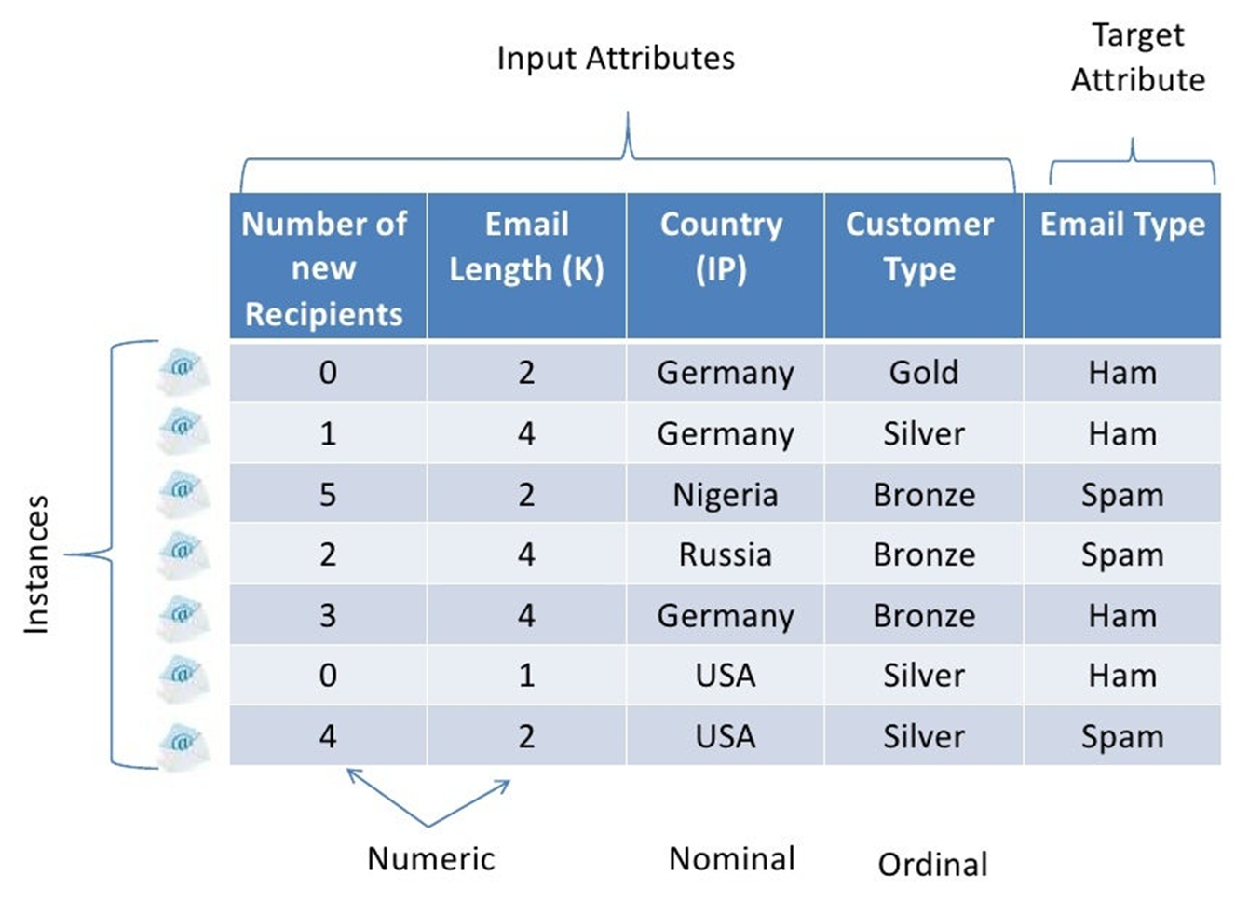
Key Terminologies

Slide 9
Key Task of Machine Learning
Classification
In classification, our job is to predict what class an instance of data should fall into.
Regression
Regression is the prediction of a numeric value.
Clustering
In unsupervised learning, there’s no label or target value given for the data.
A task where we group similar items together is known as clustering.

Slide 10
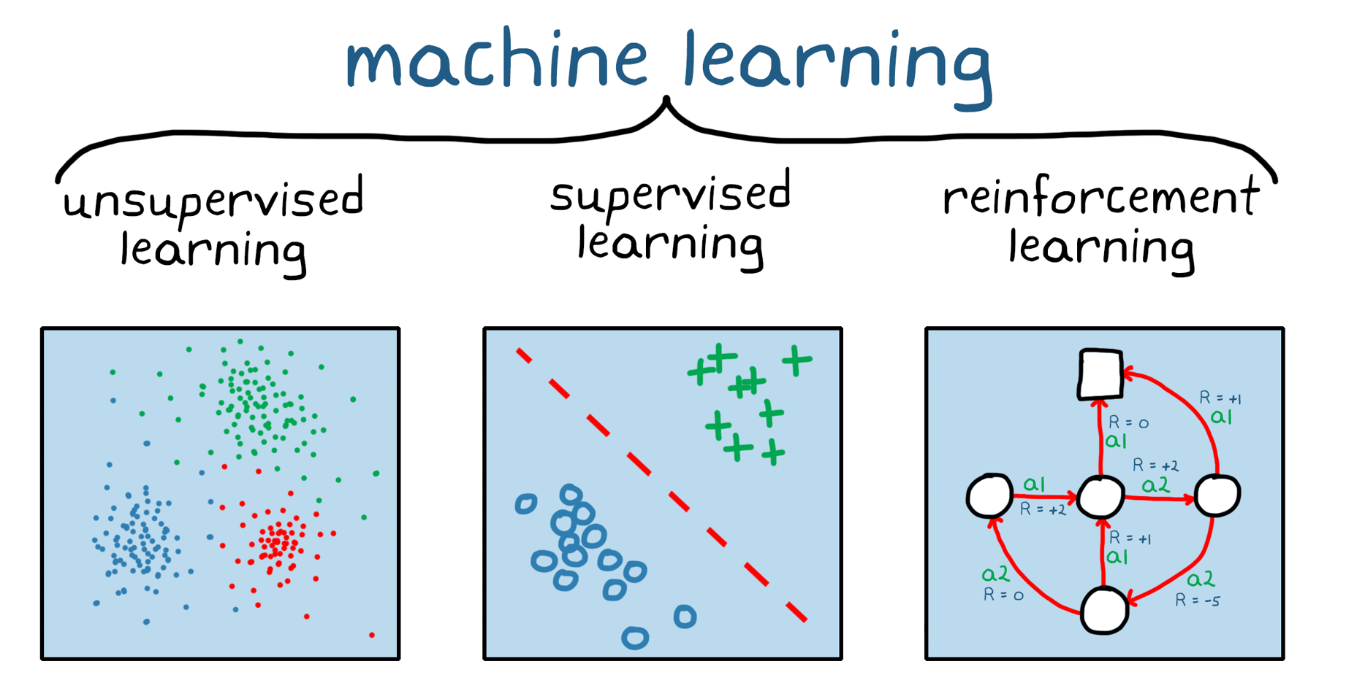
Types of Machine Learning

Slide 11
Machine Learning Classification
Machine Learning
Supervised Learning
Unsupervised Learning
Reinforcement Learning
Regression
Clustering
Linear
Semi-Supervised Learning
K-means, PCA
Multivariate
Classification
Association
Logistic, Trees, KNN, Naïve Bayes, SVM, Neural Network
Apriori

Slide 12
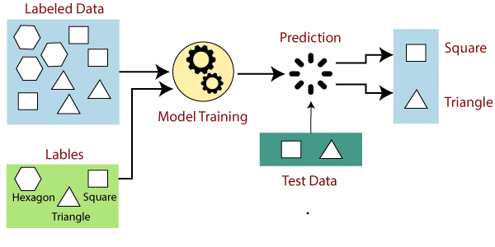
Supervised Learning
In supervised learning, models are trained using labelled dataset, where the model learns about each type of data.
Once the training process is completed, the model is tested on the basis of test data (a subset of the training set), and then it predicts the output.

Slide 13
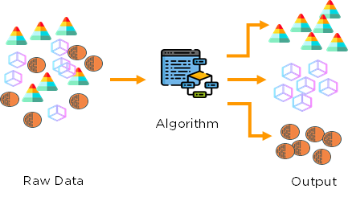
Unsupervised Learning
“Unsupervised learning is a type of machine learning in which models are trained using unlabeled dataset and are allowed to act on that data without any supervision.”
Unsupervised learning cannot be directly applied to a regression or classification problem because unlike supervised learning, we have the input data but no corresponding output data.
The goal of unsupervised learning is to find the underlying structure of dataset, group that data according to similarities, and represent that dataset in a compressed format.

Slide 14
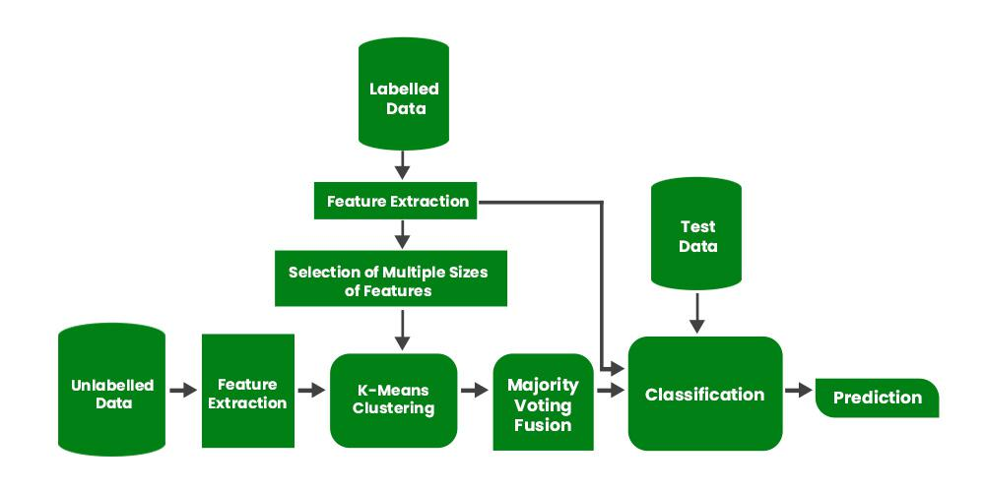
Semi Supervised Learning

Slide 15
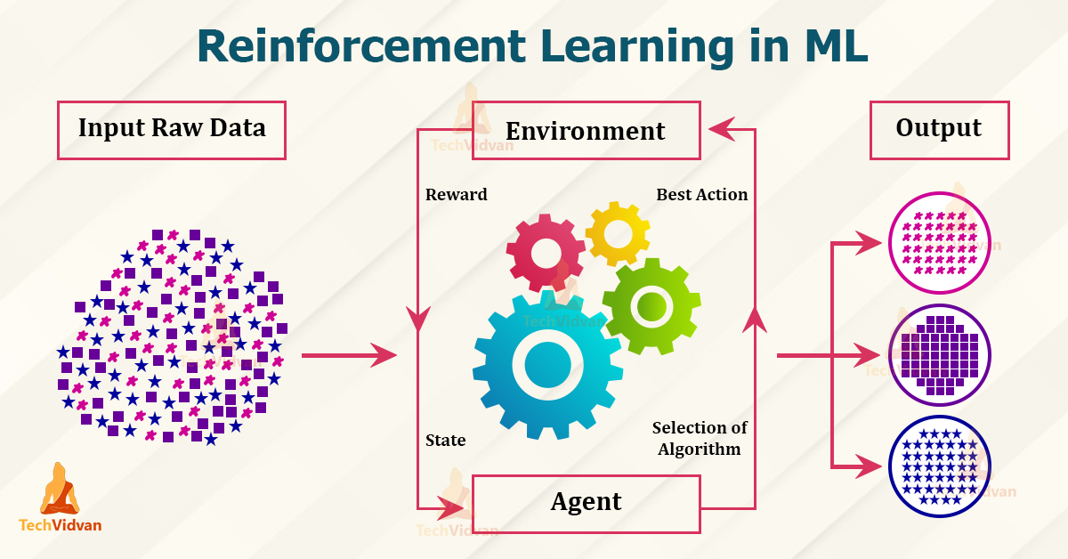
Reinforcement Learning

Slide 16
How to choose the right Algorithm
First, you need to consider your goal. What are you trying to get out of this? (Do you want a probability that it might rain tomorrow, or do you want to find groups of voters with similar interests?) What data do you have or can you collect?
If you’re trying to predict or forecast a target value, then you need to look into supervised learning. If not, then unsupervised learning is the place you want to be.
If you’ve chosen supervised learning, what’s your target value?
Is it a discrete value like Yes/No, 1/2/3, A/B/C, or Red/Yellow/Black? If so, then you want to look into classification.
If the target value can take on a number of values, say any value from 0.00 to 100.00, or -999 to 999, or +_ to -_, then you need to look into regression

Slide 17
Contd…
If you’re not trying to predict a target value, then you need to look into unsupervised learning.
Are you trying to fit your data into some discrete groups? If so and that’s all you need, you should look into clustering.
Do you need to have some numerical estimate of how strong the fit is into each group? If you answer yes, then you probably should look into a density estimation algorithm.
You should spend some time getting to know your data, and the more you know about it, the better you’ll be able to build a successful application.

Slide 18
Steps in developing a machine learning application
Collect data
Prepare the input data
Analyse the input data
Train the algorithm
Test the algorithm
Use it

Slide 19
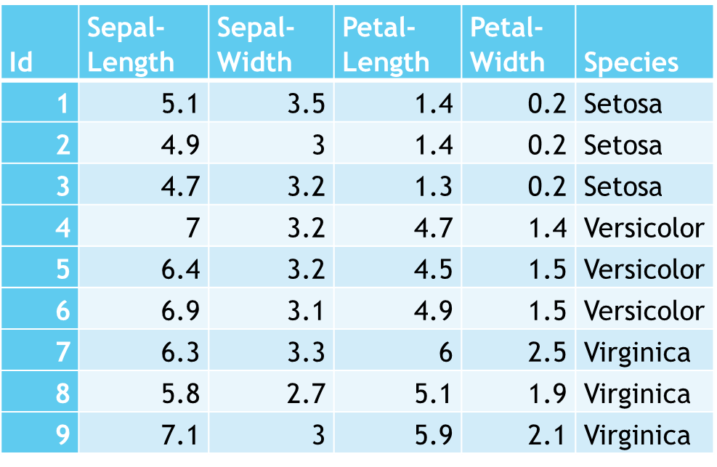
Reading a dataset
Continuous Data
Categorical Data
ID | Marital Status | Race | Sex
1 | Widowed | White | Female
2 | Widowed | White | Female
3 | Widowed | Black | Female
4 | Divorced | White | Female
5 | Separated | White | Female
6 | Divorced | White | Female
7 | Separated | White | Male
8 | Never-married | White | Female
9 | Divorced | White | Female
10 | Never-married | White | Male
Income
<=50K
<=50K
<=50K
<=50K
<=50K
<=50K
<=50K
>50K
<=50K
>50K
Continuous Data
Categorical Data
Targets (Categorical / Continuous )
Features / Attributes
Classes
Training Set / Testing Set

Slide 20
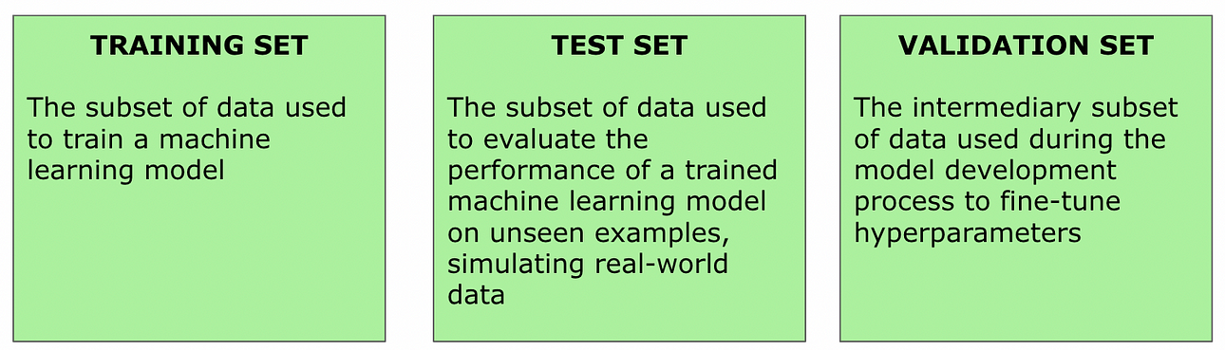
Training, Testing and Validation Dataset

Slide 21
Cross Validation
In machine learning, we couldn’t fit the model on the training data and can’t say that the model will work accurately for the real data. For this, we must assure that our model got the correct patterns from the data, and it is not getting up too much noise. For this purpose, we use the cross-validation technique.
Cross validation is a technique used in machine learning to evaluate the performance of a model on unseen data. It involves dividing the available data into multiple folds or subsets, using one of these folds as a validation set, and training the model on the remaining folds. This process is repeated multiple times, each time using a different fold as the validation set. Finally, the results from each validation step are averaged to produce a more robust estimate of the model’s performance.

Slide 22

Cross Validation

Slide 23
Overfitting and Underfitting
When we talk about the Machine Learning model, we actually talk about how well it performs and its accuracy which is known as prediction errors.
Let us consider that we are designing a machine learning model.
A model is said to be a good machine learning model if it generalizes any new input data from the problem domain in a proper way.
This helps us to make predictions about the future data, that the data model has never seen.
Now, suppose we want to check how well our machine learning model learns and generalizes to the new data.
For that, we have overfitting and underfitting, which are majorly responsible for the poor performances of the machine learning algorithms.

Slide 24
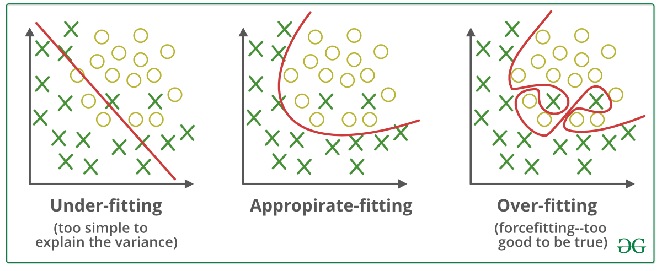
Overfitting and Underfitting

Slide 25
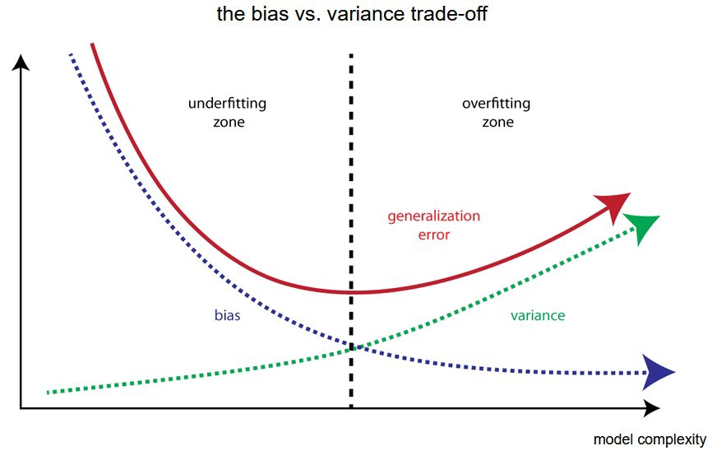
Bias and Variance
Bias: Assumptions made by a model to make a function easier to learn. It is actually the error rate of the training data. When the error rate has a high value, we call it High Bias and when the error rate has a low value, we call it low Bias.
Variance: The error rate of the testing data is called variance. When the error rate has a high value, we call it High variance and when the error rate has a low value, we call it Low variance.

Slide 26
Bias and Variance
Low Bias: Suggests less assumptions about the form of the target function.
High-Bias: Suggests more assumptions about the form of the target function.
Low Variance: Suggests small changes to the estimate of the target function with changes to the training dataset.
High Variance: Suggests large changes to the estimate of the target function with changes to the training dataset.

Slide 27
Underfitting
A statistical model or a machine learning algorithm is said to have underfitting when it cannot capture the underlying trend of the data, i.e., it only performs well on training data but performs poorly on testing data.
Underfitting destroys the accuracy of our machine learning model.
Its occurrence simply means that our model or the algorithm does not fit the data well enough.
An underfitted model has high bias and low variance.

Slide 28
Underfitting
It usually happens when we have fewer data to build an accurate model and also when we try to build a linear model with fewer non-linear data.
In such cases, the rules of the machine learning model are too easy and flexible to be applied on such minimal data and therefore the model will probably make a lot of wrong predictions.
Underfitting can be avoided by using more data and also increasing the features by feature selection.

Slide 29
Underfitting
Reasons for Underfitting:
High bias and low variance
The size of the training dataset used is not enough.
The model is too simple.
Training data is not cleaned and also contains noise in it.
Techniques to reduce underfitting:
Increase model complexity
Increase the number of features, performing feature engineering
Remove noise from the data.
Increase the number of epochs or increase the duration of training to get better results.

Slide 30
Overfitting
A statistical model is said to be overfitted when the model does not make accurate predictions on testing data.
When a model gets trained with so much data, it starts learning from the noise and inaccurate data entries in our data set.
And when testing with test data results in High variance.
Then the model does not categorize the data correctly, because of too many details and noise.
The causes of overfitting are the non-parametric and non-linear methods because these types of machine learning algorithms have more freedom in building the model based on the dataset and therefore they can really build unrealistic models.

Slide 31
Overfitting
A solution to avoid overfitting is using a linear algorithm if we have linear data or using the parameters like the maximal depth if we are using decision trees.
Very Good Validation Accuracy and Very Poor Testing Accuracy.
The overfitted model has low bias and high variance.

Slide 32
Overfitting
Reasons for Overfitting are as follows:
High variance and low bias
The model is too complex
The size of the training data
Techniques to reduce overfitting:
Increase training data.
Reduce model complexity.
Early stopping during the training phase (have an eye over the loss over the training period as soon as loss begins to increase stop training).
Ridge Regularization and Lasso Regularization
Use dropout for neural networks to tackle overfitting.

Slide 33
Overfitting and Underfitting
Use these steps to determine if your machine learning model, deep learning model or neural network is currently underfit or overfit.
Ensure that you are using validation loss next to training loss in the training phase.
When your validation loss is decreasing, the model is still underfit.
When your validation loss is increasing, the model is overfit.
When your validation loss is equal, the model is either perfectly fit or in a local minimum.

Slide 34
Issues in Machine Learning
Which Algorithm to select?
How much training data is sufficient?
Prior knowledge held by the learner is used at which time and manner to guide the process of generalization from examples?
What is the best strategy for choosing a useful next training experience, and how does the choice of this strategy affect the complexity of the learning problem?
To reduce the task of learning approximation of the problems is carriedout, what will be the best approach?
To improve the knowledge representation and to learn the target function, how can the learner automatically alter its representation?

Slide 35
Applications of Machine Learning
Automating Employee Access Control
Protecting Animals
Predicting Emergency Room Wait Times
Identifying Heart Failure
Predicting Strokes and Seizures
Predicting Hospital Readmissions
Stop Malware
Understand Legalese
Improve Cybersecurity
Get Ready For Smart Cars

Slide 36
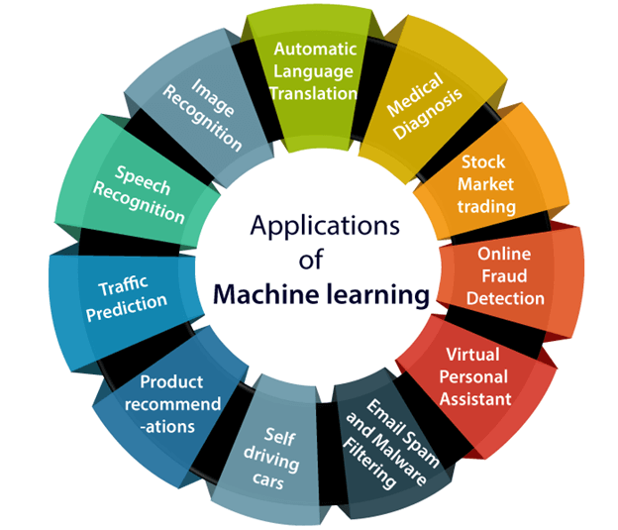
Applications of Machine Learning

